Slide 1
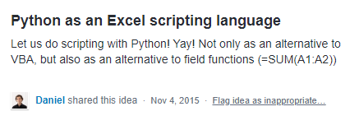
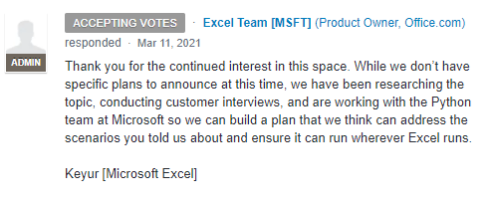
how it started how it’s going

Slide 2
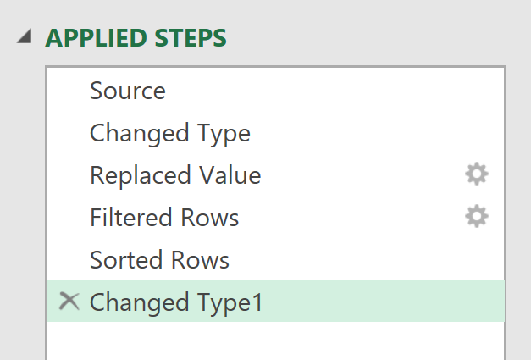
EVERY STEP YOU TAKE
I’LL BE WATCHING YOU

Slide 3

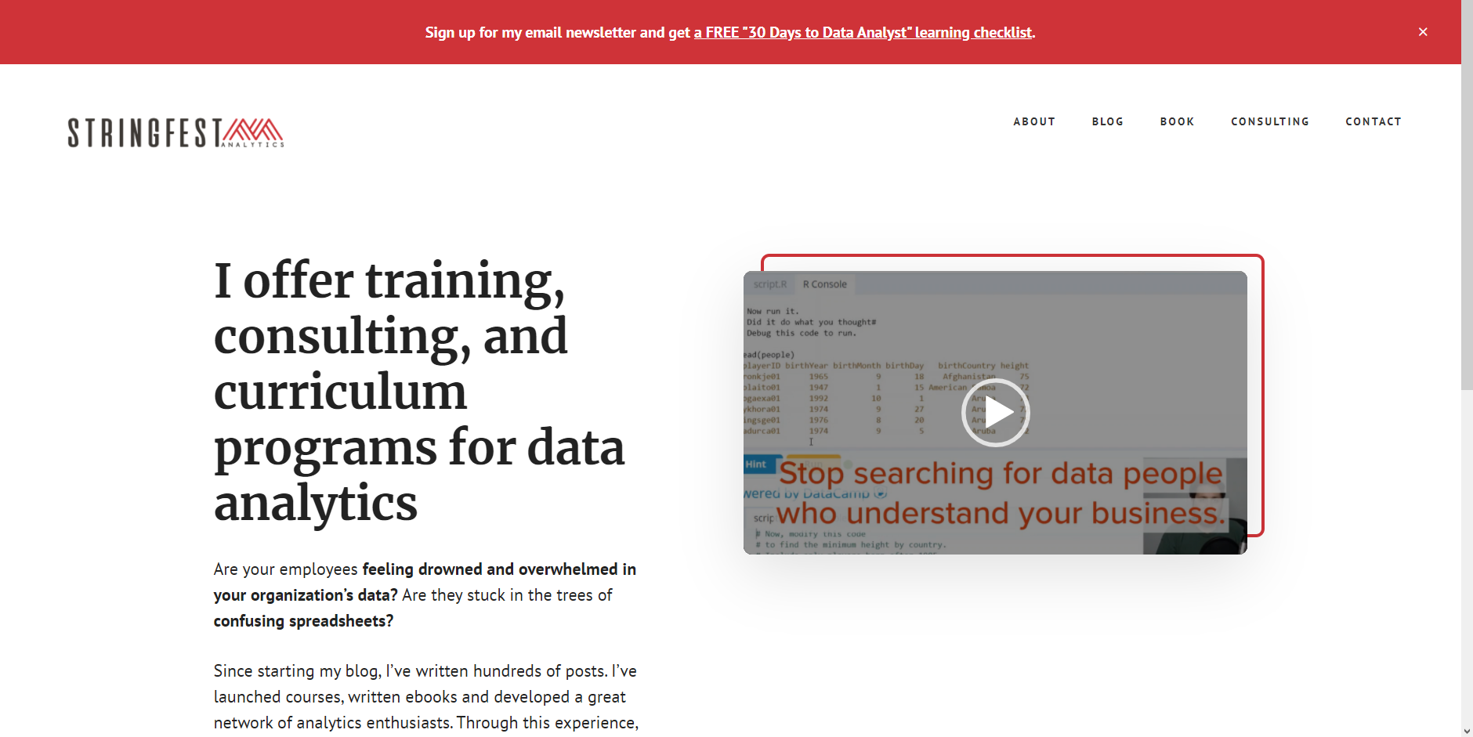
how it started
how it’s going

Slide 4

DATA ANALYSTS
R/PYTHON
R/PYTHON
R/PYTHON
ADVANCED ANALYTICS
REPRODUCIBLE PROJECTS
AUTOMATED TASKS
COMPELLING VISUALIZATIONS
HIGHER PAY

Slide 5


ANALYSTS
ACCOUNTANTS
MARKETERS
INVESTORS
TEACHERS
ENGINEERS
ECOLOGISTS
EVALUATORS
PHYSICIANS
ADMINISTRATORS

Slide 6


CLIPPY GETS HIS REVENGE

Slide 7

BI tool with limited statistical capabilities:
“Sure, we can do AI…”

Slide 8

When you search online to get help and your own post shows up

Slide 9

Working on a business project
Working on a business project with an upcoming deadline

Slide 10

Technical debt

Slide 11

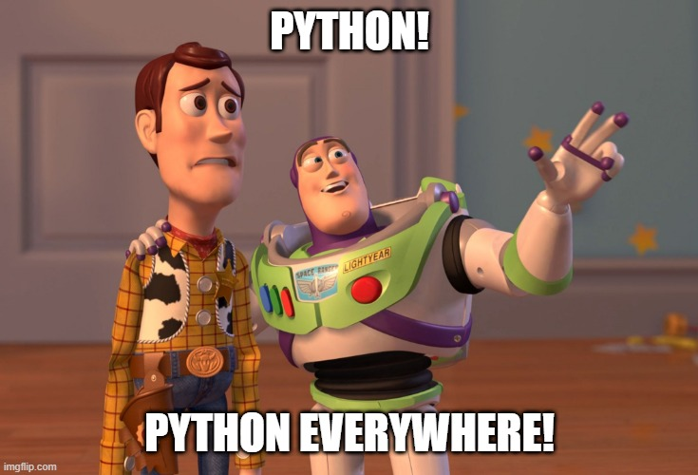




Slide 12

Salesman: *slaps roof*
“This dashboard can fit so much chartjunk in it”

Slide 13


*Slaps cover*
“This baby makes a great Christmas gift”

Slide 14


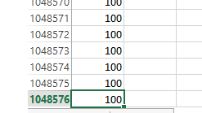

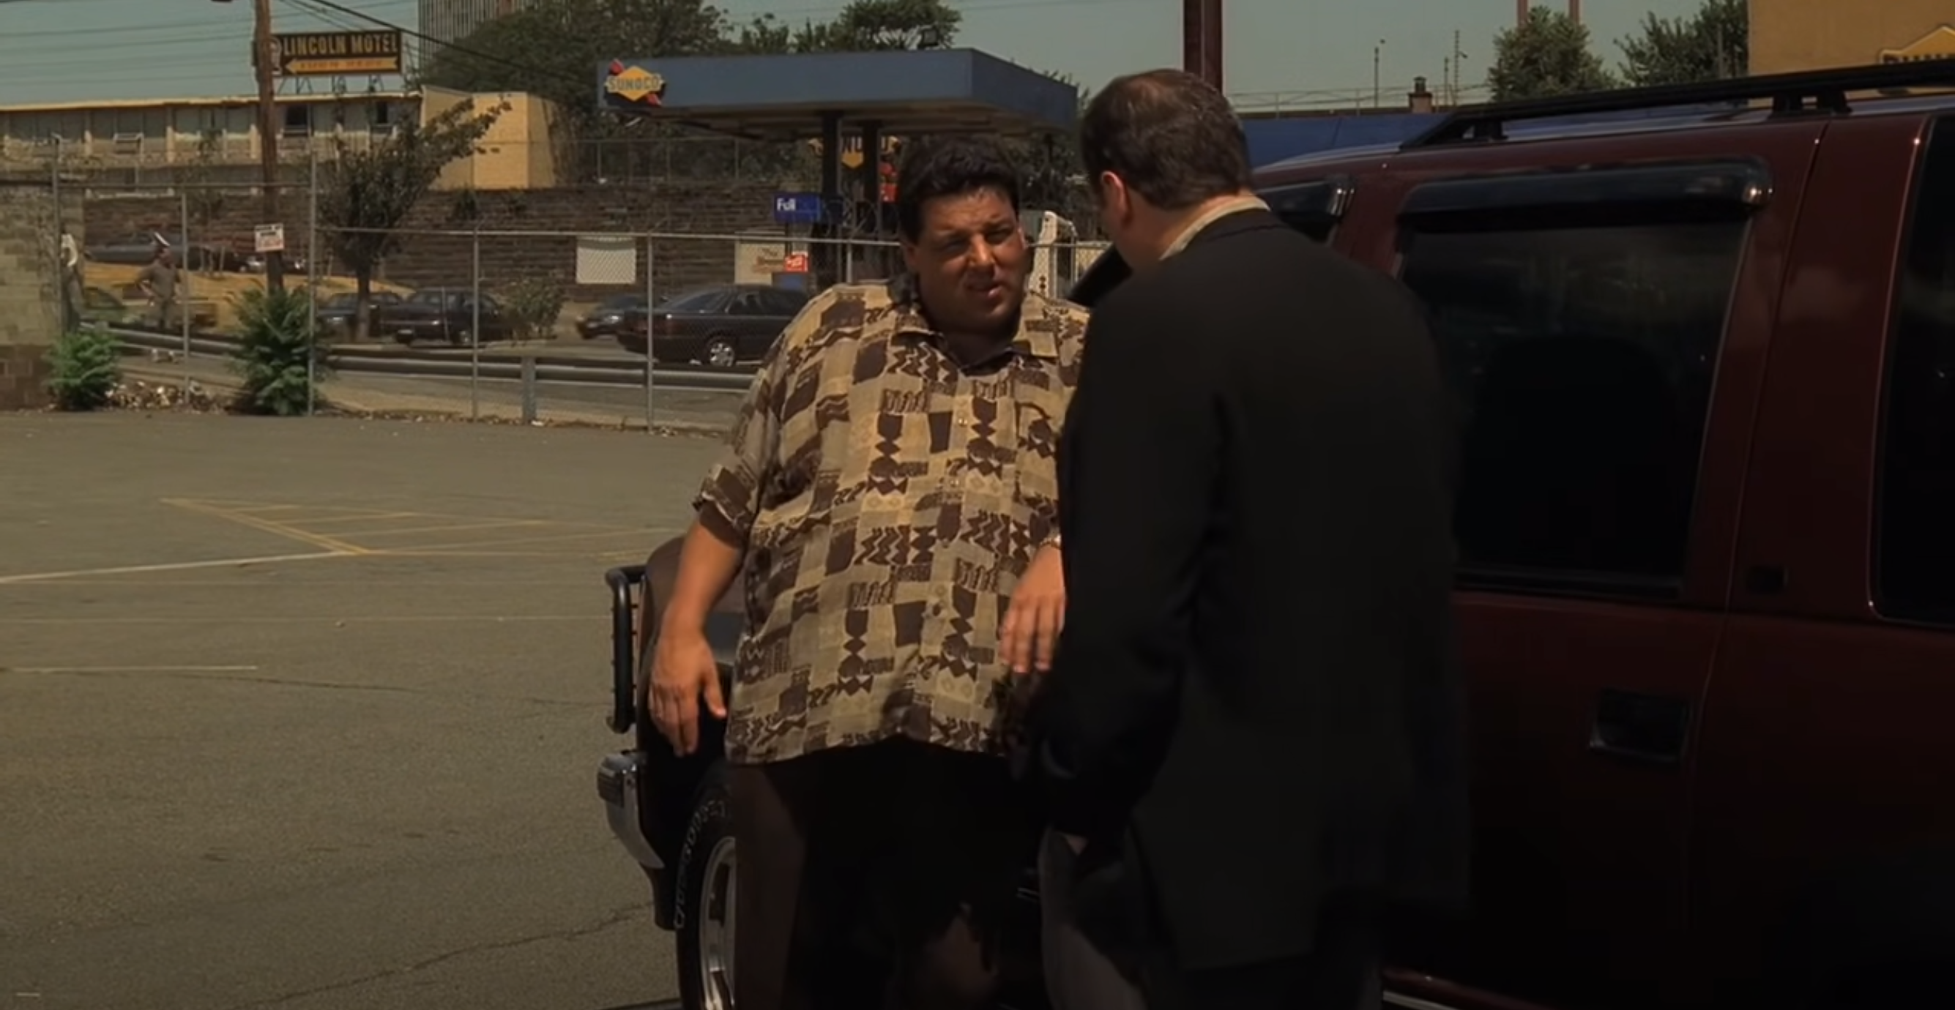


I think it's time for you to start to seriously consider Power Query.
What do you mean?
What do I mean? I mean convert that data into a table before you crash the file, you fat workbook.

Slide 15



Slide 16

“It’s not about the tools, it’s about asking the right questions”
Ought implies can. You can’t answer the questions without the tools

